Slide 1
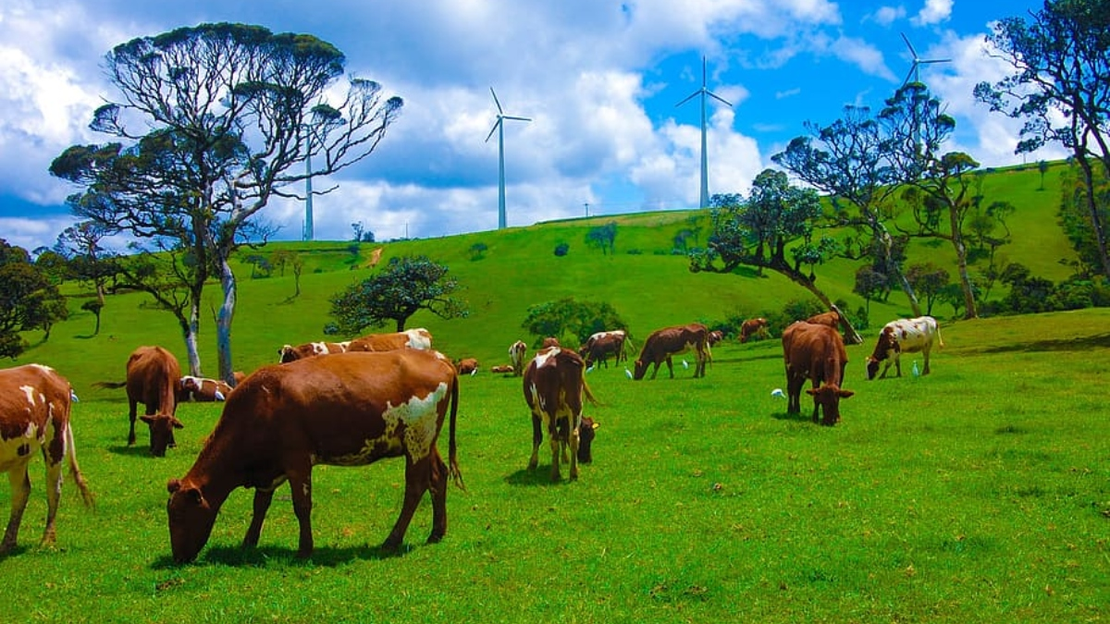
A Centralized System for Real-Time Farm Animal Disease Reporting
ADRS
A centralized real-time farm disease reporting platform for Farmers and Veterinary Officers

Slide 2

2 Minute Introduction Video

Slide 3
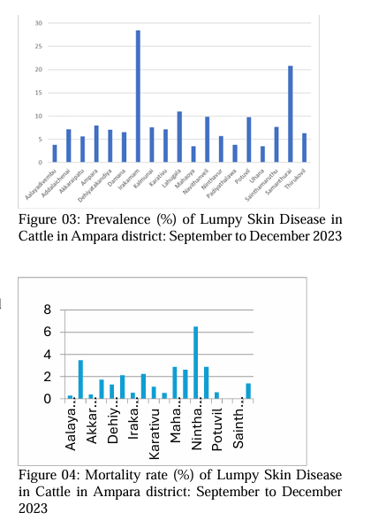
Problem & Need
Uncontained Outbreak Volatility: FMD and LSD show massive, alternating spikes (surpassing 200,000+ cases), proving diseases spread widely before intervention occurs.
Failure of Reactive Healthcare: The current delayed reporting model only responds after peak infection, proving it is highly ineffective.
Devastating Economic Impact: These massive infection surges directly translate to severe income loss for vulnerable rural farmers.

Slide 4
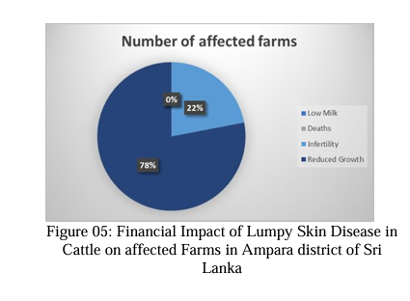
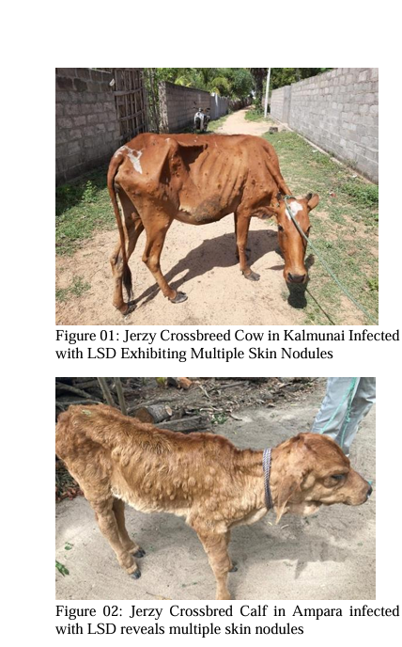
Problem & Need
Financial Impact of Lumpy Skin Disease in Ampara
The Clinical Reality: Highly contagious diseases, such as Lumpy Skin Disease (LSD), cause severe physical distress and drastic drops in livestock production.
Failure of Reactive Surveillance: The current veterinary model only intervenes after animals reach this advanced, highly infectious stage, allowing the disease to spread to the rest of the herd.

Slide 5

01
Project Overview

Slide 6
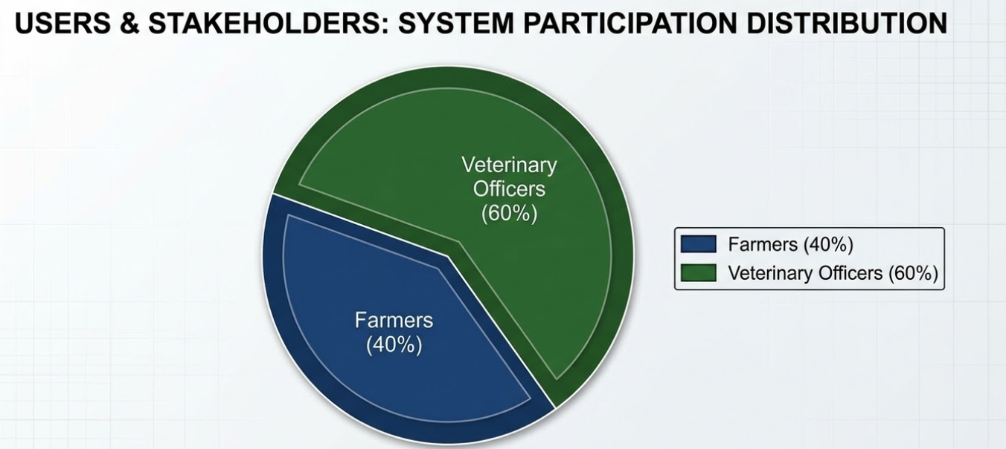
Users and Stakeholders
Core Operators (Manage Closely): Field veterinary officers wield high power and interest; they rely on ADRS for verified, real-time outbreak data to deploy interventions.
Primary Beneficiaries (Keep Informed): Farmers lack systemic power but have the highest personal stakes; ADRS empowers them directly with accessible, early-warning mobile triage.

Slide 7
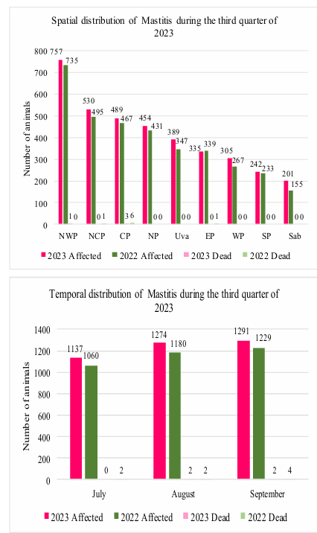
Impact on Users & Society
Catastrophic Income Loss (Users): Farmers bear the brunt of the reactive healthcare model, suffering severe financial ruin from plummeting milk yields and livestock mortality.
Threat to National Food Security (Society): Uncontrolled epidemics of FMD and LSD severely disrupt the national dairy and protein supply chains, causing market instability.

Slide 8
Existing Solutions & Their Limitations
Feature / Requirement | Traditional Systems / PLF | ADRS (Our Solution)
Accessibility | Expensive 3D Sensors | Low-cost 2D Mobile
AI Reliability | Hallucinates on bad images | OOD Integrity-Gated
Outbreak Tracking | Retrospective / Static | Real-Time ST-DBSCAN
Data Handling | Requires dense, clean data | Handles Zero-Heavy Data
Prohibitive Costs & Hardware: Current Precision Livestock Farming (PLF) relies on expensive 3D sensors and continuous IoT, placing them entirely out of reach for farmers.
AI Hallucinations & Single-Disease Focus: Standard veterinary AI models operate in a "closed-world" setting—forcing diagnoses on poor-quality images and failing to detect overlapping comorbidities.

Slide 9
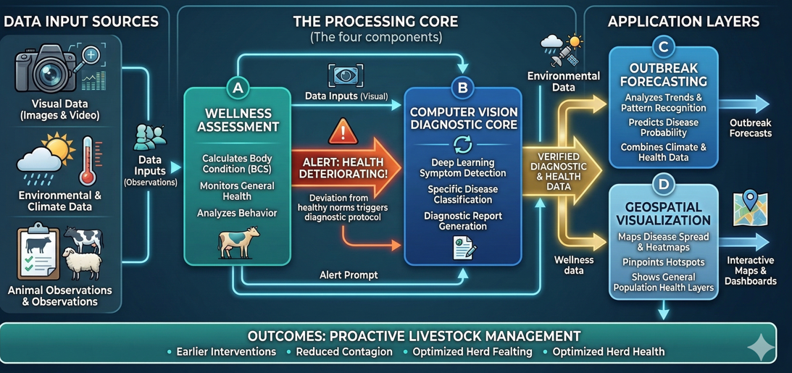
Solution Overview
Step 1 - Mobile Triage: Fuses 2D farm images, logs, and weather (THI) to flag early health risks.
Step 2 - AI Verification: Integrity-gated models reject bad images and detect overlapping diseases (comorbidities).
Step 3 - Live Spatial Mapping: Plots active outbreak clusters and predicts physical spread trajectories.
Step 4 - Climate Forecasting: Fuses case data with climate APIs for district-level risk alerts on a unified dashboard.

Slide 10

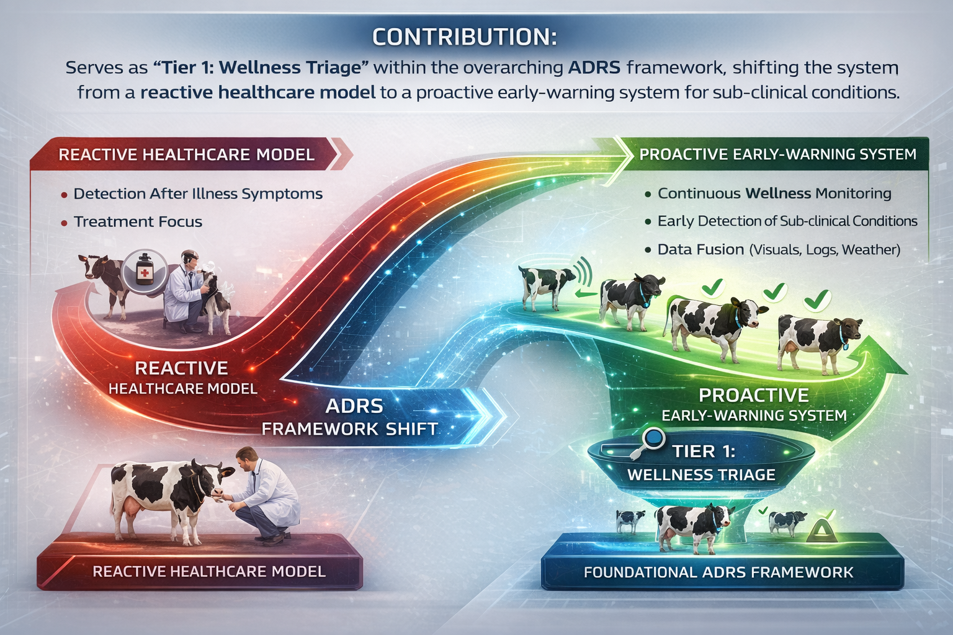
AI-Driven Wellness and Management Standardization
IT22194558 | W.M.P.J Wijenayake
IT22194558 | W.M.P.J Wijenayake | R26-SE-013
​

Slide 11
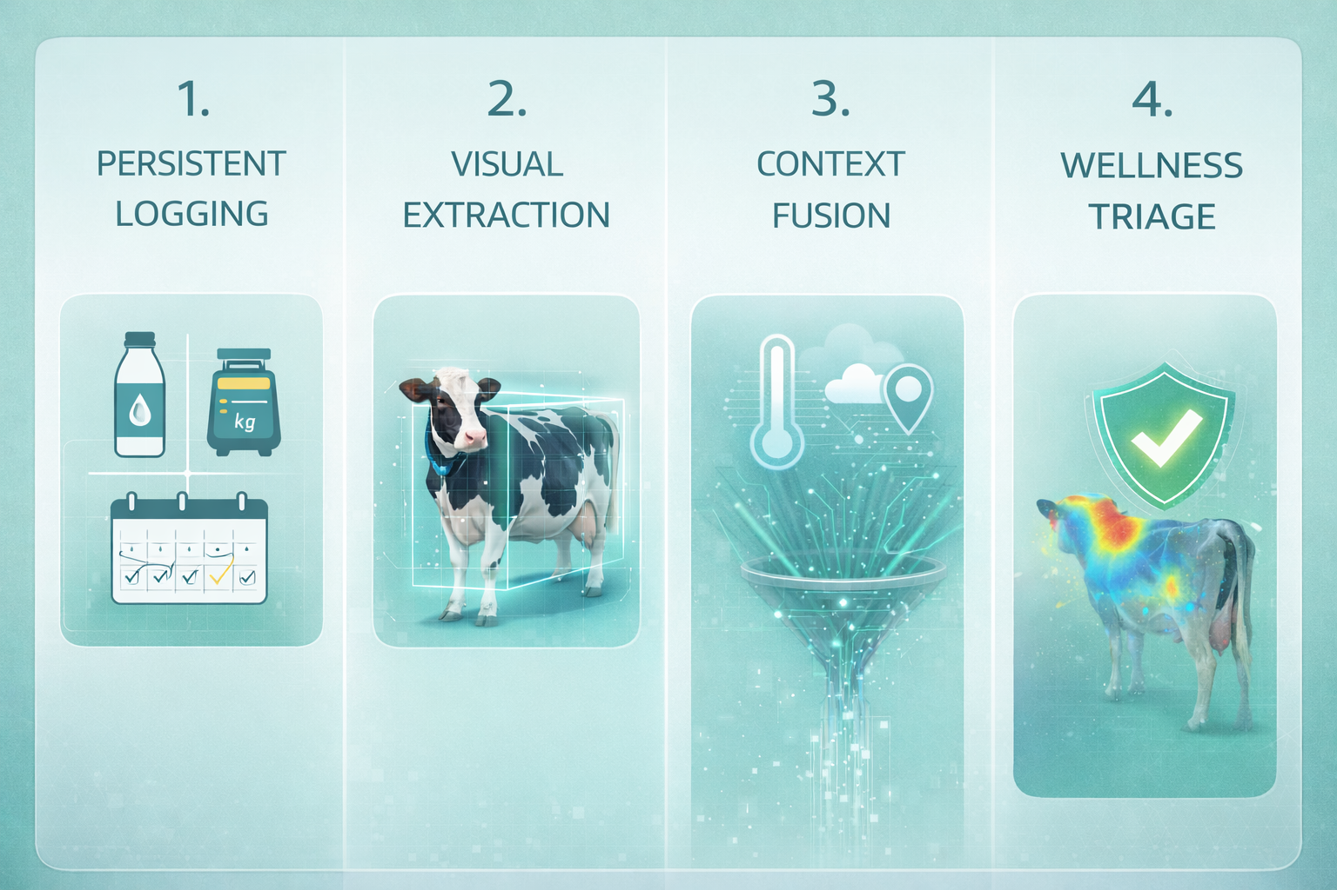
AI-Driven Wellness and Management Standardization
Contribution: Serves as "Tier 1: Wellness Triage" for the ADRS, shifting dairy healthcare from reactive to proactive.
Problem Definition: Reactive healthcare in tropical dairy farms leads to delayed treatments and a 20-30% loss in potential milk yield. Existing PLF systems lack tropical context and require unaffordable 3D sensors .
IT22194558 | W.M.P.J Wijenayake | R26-SE-013​
​​
​

Slide 12

AI-Driven Wellness and Management Standardization
Research Objectives: To develop a lightweight YOLOv8 BCS estimator and an Explainable Prescriptive Engine using Grad-CAM heatmaps to provide actionable non-medical guidance.
Novelty: Introduces a "Dual-Trigger" triage logic (Manual & Anomaly-driven) and Context-Aware Multi-modal Fusion (combining 2D visuals + 7-day logs + THI)
IT22194558 | W.M.P.J Wijenayake | R26-SE-013​​
​​​
​​
​

Slide 13
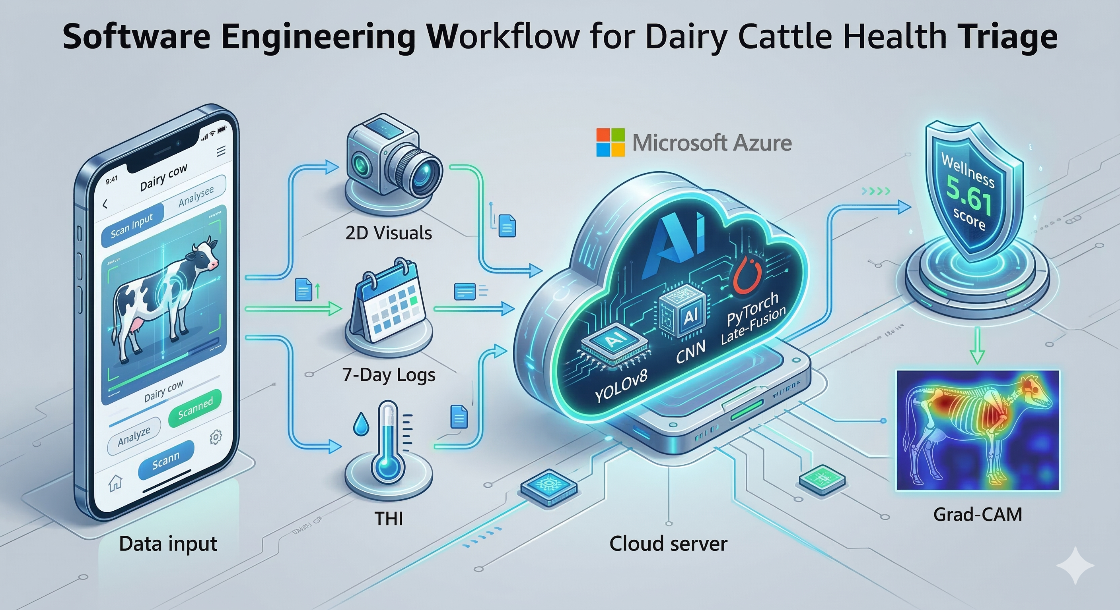
AI-Driven Wellness and Management Standardization
Work Flow
IT22194558 | W.M.P.J Wijenayake | R26-SE-013​​​
​​​​
​​​
​​
​

Slide 14

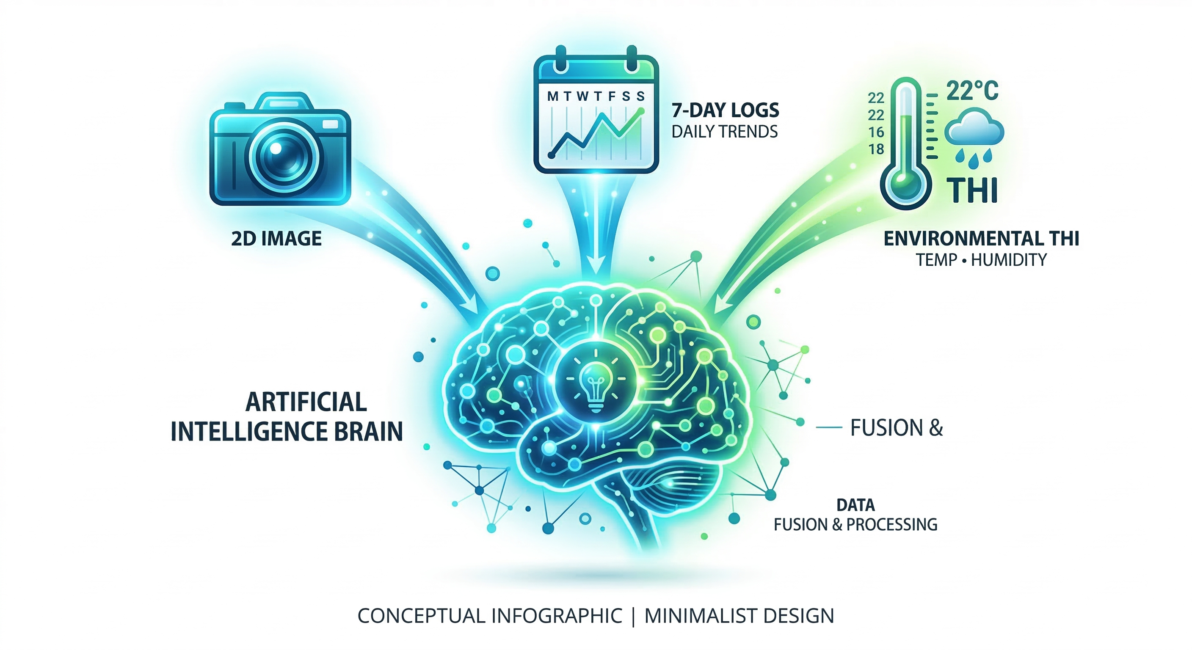
AI-Driven Wellness and Management Standardization
Domain Knowledge & Technologies
Research Methodology: * Domain: Software Engineering.
  Method: Design Science Research (DSR) with Agile Scrum sprints.
Latest Technologies:
  Architecture: Decoupled React.js (Frontend) + FastAPI on Microsoft Azure (Backend) for scalable CI/CD.
  Computer Vision: YOLOv8 (Segmentation) & CNN-Regression (BCS).
Deep Learning: Late-Fusion Neural Networks (PyTorch).
IT22194558 | W.M.P.J Wijenayake | R26-SE-013​
​​
​

Slide 15
Validation and Data Security
Validation: Evaluated via Baseline Comparison (Multi-modal vs. Visual-only). Metrics include RMSE (BCS accuracy) and Confusion Matrix (overall triage F1-Score) .
Data & Security: Hybrid dataset (Primary field 2D images + Mendeley). Securely stored using HTTPS, JWT, and Azure
IT22194558 | W.M.P.J Wijenayake | R26-SE-013​
​​
​

Slide 16
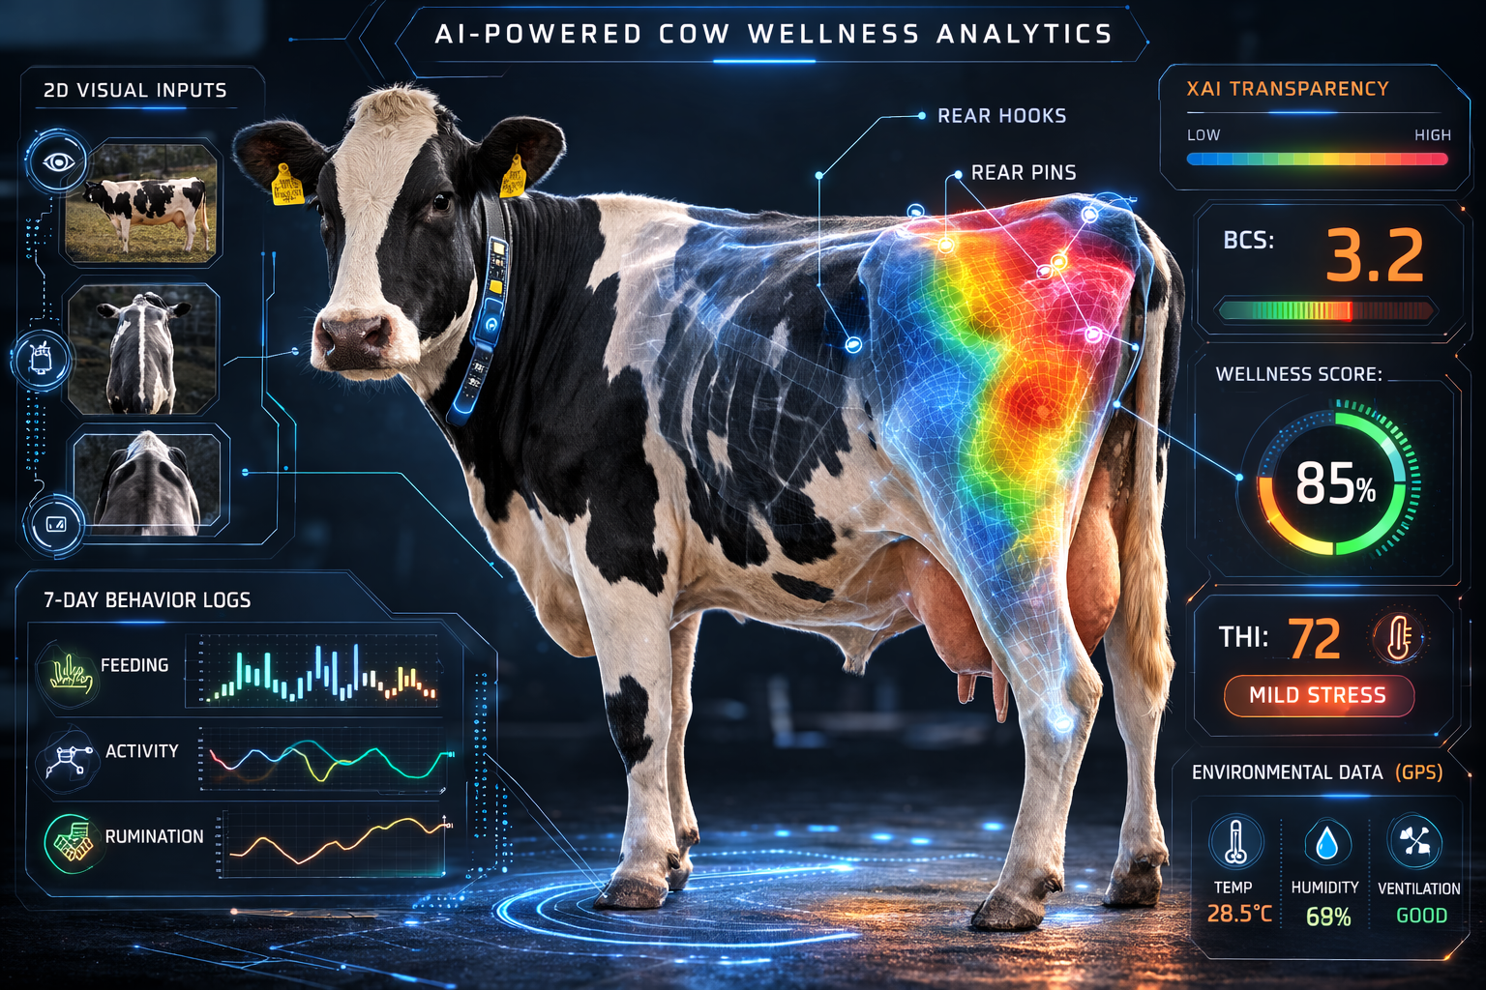
Implementation Details & Dependencies
System Overview:
Stage 1: Persistent logs trigger triage; YOLOv8 extracts rear-quarter (enhanced via CLAHE) for BCS.
Stage 2: GPS fetches real-time temperature/humidity to calculate THI.
Stage 3: Late-Fusion Neural Network fuses BCS, logs, and THI.
Stage 4: Outputs wellness classification and Grad-CAM XAI heatmap.
Dependencies:
Requires OpenWeatherMap API for THI.
Feeds validated diagnostic payloads to the central ADRS database.
IT22194558 | W.M.P.J Wijenayake | R26-SE-013​​
​​​
​​
​

Slide 17
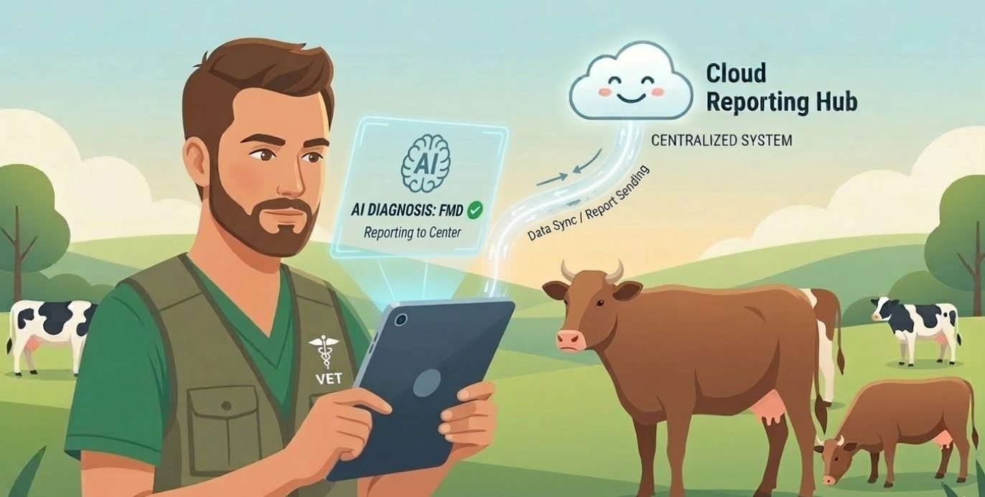
02
AI-Powered Smart Diagnosis

Slide 18

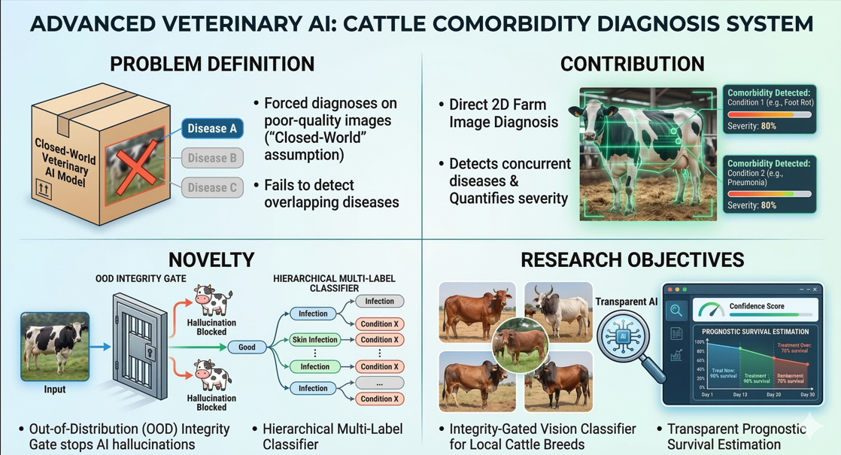
AI-Powered Smart Diagnosis
Contribution: Detects concurrent diseases (comorbidities) and quantifies disease severity directly from 2D farm images.
Novelty: Features an Out-of-Distribution (OOD) Integrity Gate to prevent AI hallucinations, combined with a Hierarchical Multi-Label Classifier.
Problem Definition: Standard veterinary AI models force diagnoses on poor-quality images ("Closed-World" assumption) and fail to detect overlapping diseases.
Research Objectives: Develop an integrity-gated vision classifier for local cattle breeds, incorporating a transparent prognostic survival estimation.
IT21129544| Athulathmudali A.L.M | R26-SE-013

Slide 19
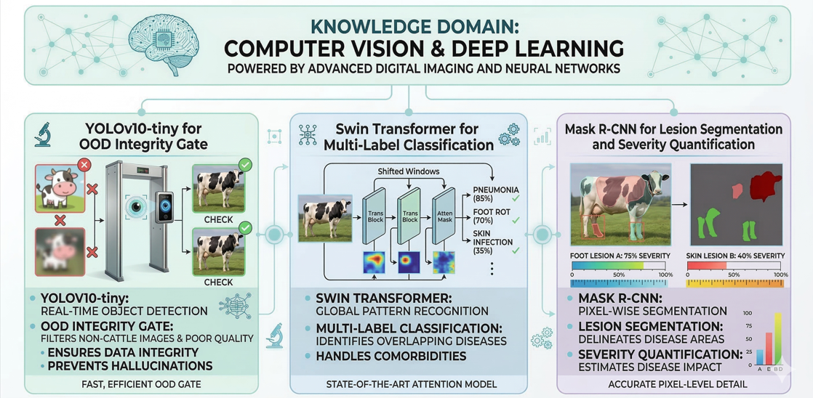
AI-Powered Smart Diagnosis
Knowledge Domain: Computer Vision and Deep Learning.
Latest Technologies Utilized: * YOLOv10-tiny for the OOD Integrity Gate.
Swin Transformer for Multi-Label Classification.
Mask R-CNN for Lesion Segmentation and Severity Quantification.
IT21129544| Athulathmudali A.L.M | R26-SE-013

Slide 20
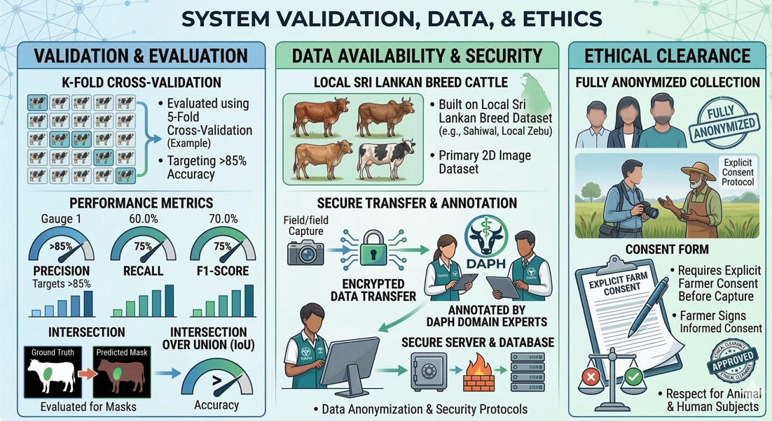
AI-Powered Smart Diagnosis
Validation & Evaluation: Evaluated using K-Fold Cross-Validation (targeting >85% accuracy), measured via Precision, Recall, F1-Score, and Intersection over Union (IoU) for masks.
Data Availability & Security: Built on a primary 2D image dataset of local Sri Lankan breeds, securely transferred and annotated by DAPH domain experts.
Ethical Clearance: Fully anonymized image collection requiring explicit farmer consent before capture.
IT21129544| Athulathmudali A.L.M | R26-SE-013

Slide 21
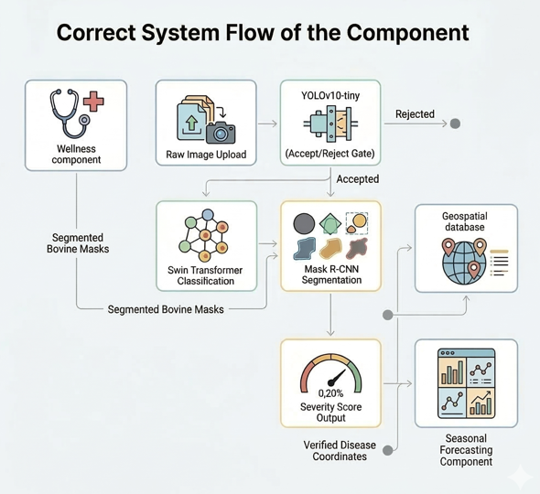
AI-Powered Smart Diagnosis
System Overview: Raw Image Upload → YOLOv10-tiny (Accept/Reject Gate) → Swin Transformer Classification → Mask R-CNN Segmentation → Severity Score Output.
Dependencies & Common Components: Consumes cleanly segmented bovine masks from the Wellness component; feeds verified positive disease coordinates into the Geospatial database for live tracking.
IT21129544| Athulathmudali A.L.M | R26-SE-013

Slide 22

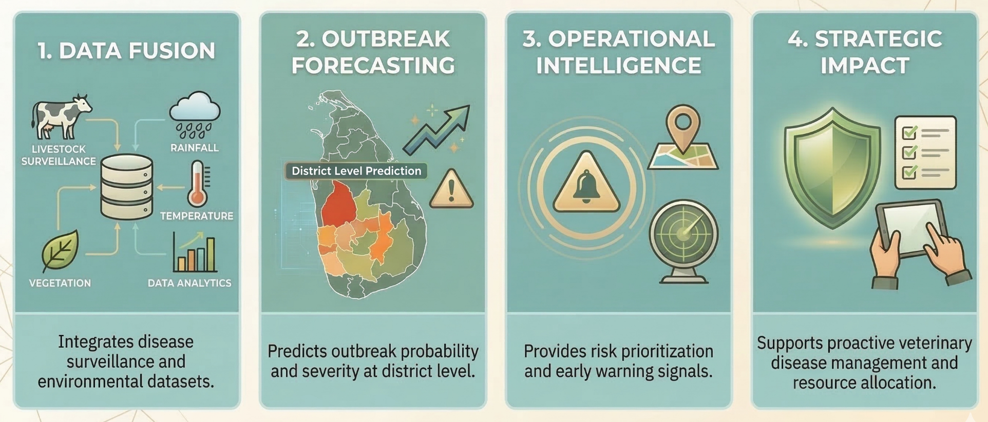
IT22221414 | Kumarasinghe S.S
Climate-Informed Livestock Disease Forecasting and Early Warning Module
Module Contribution
IT22221414 | Kumarasinghe S.S | R26-SE-013

Slide 23
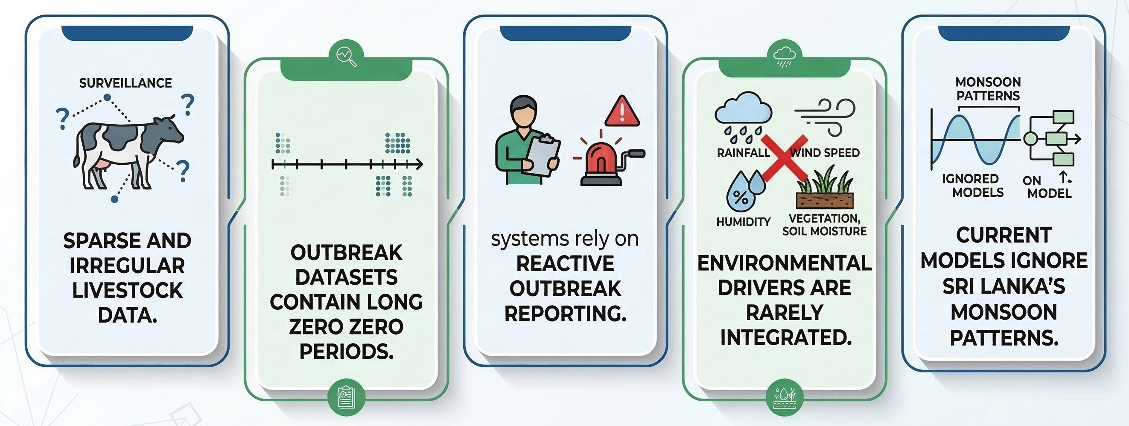
Individual Title
Problem Definition
Novelty
Sparse surveillance data reconstruction into a ML-ready district–month dataset.
Two-stage outbreak modelling designed for handling zero-heavy epidemiological data.
Climate-informed livestock disease forecasting integrating environmental drivers.
Monsoon-informed seasonal feature engineering specific to Sri Lanka.
Uncertainty-aware and explainable outbreak forecasting using bootstrap intervals and SHAP.
IT22221414 | Kumarasinghe S.S | R26-SE-013

Slide 24

Individual Title
Main Research Objective
Develop a climate-informed livestock disease forecasting and early warning module that integrates epidemiological surveillance data with environmental datasets to predict outbreak probability and severity.
Sub-Objectives
IT22221414 | Kumarasinghe S.S | R26-SE-013

Slide 25
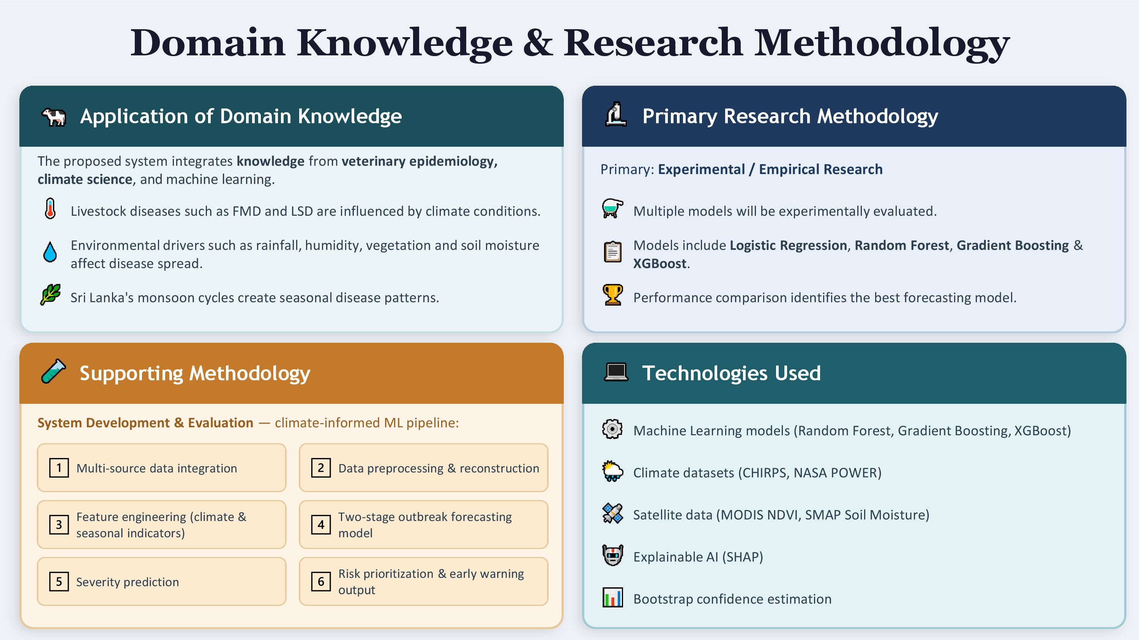
Individual Title
IT22221414 | Kumarasinghe S.S | R26-SE-013

Slide 26
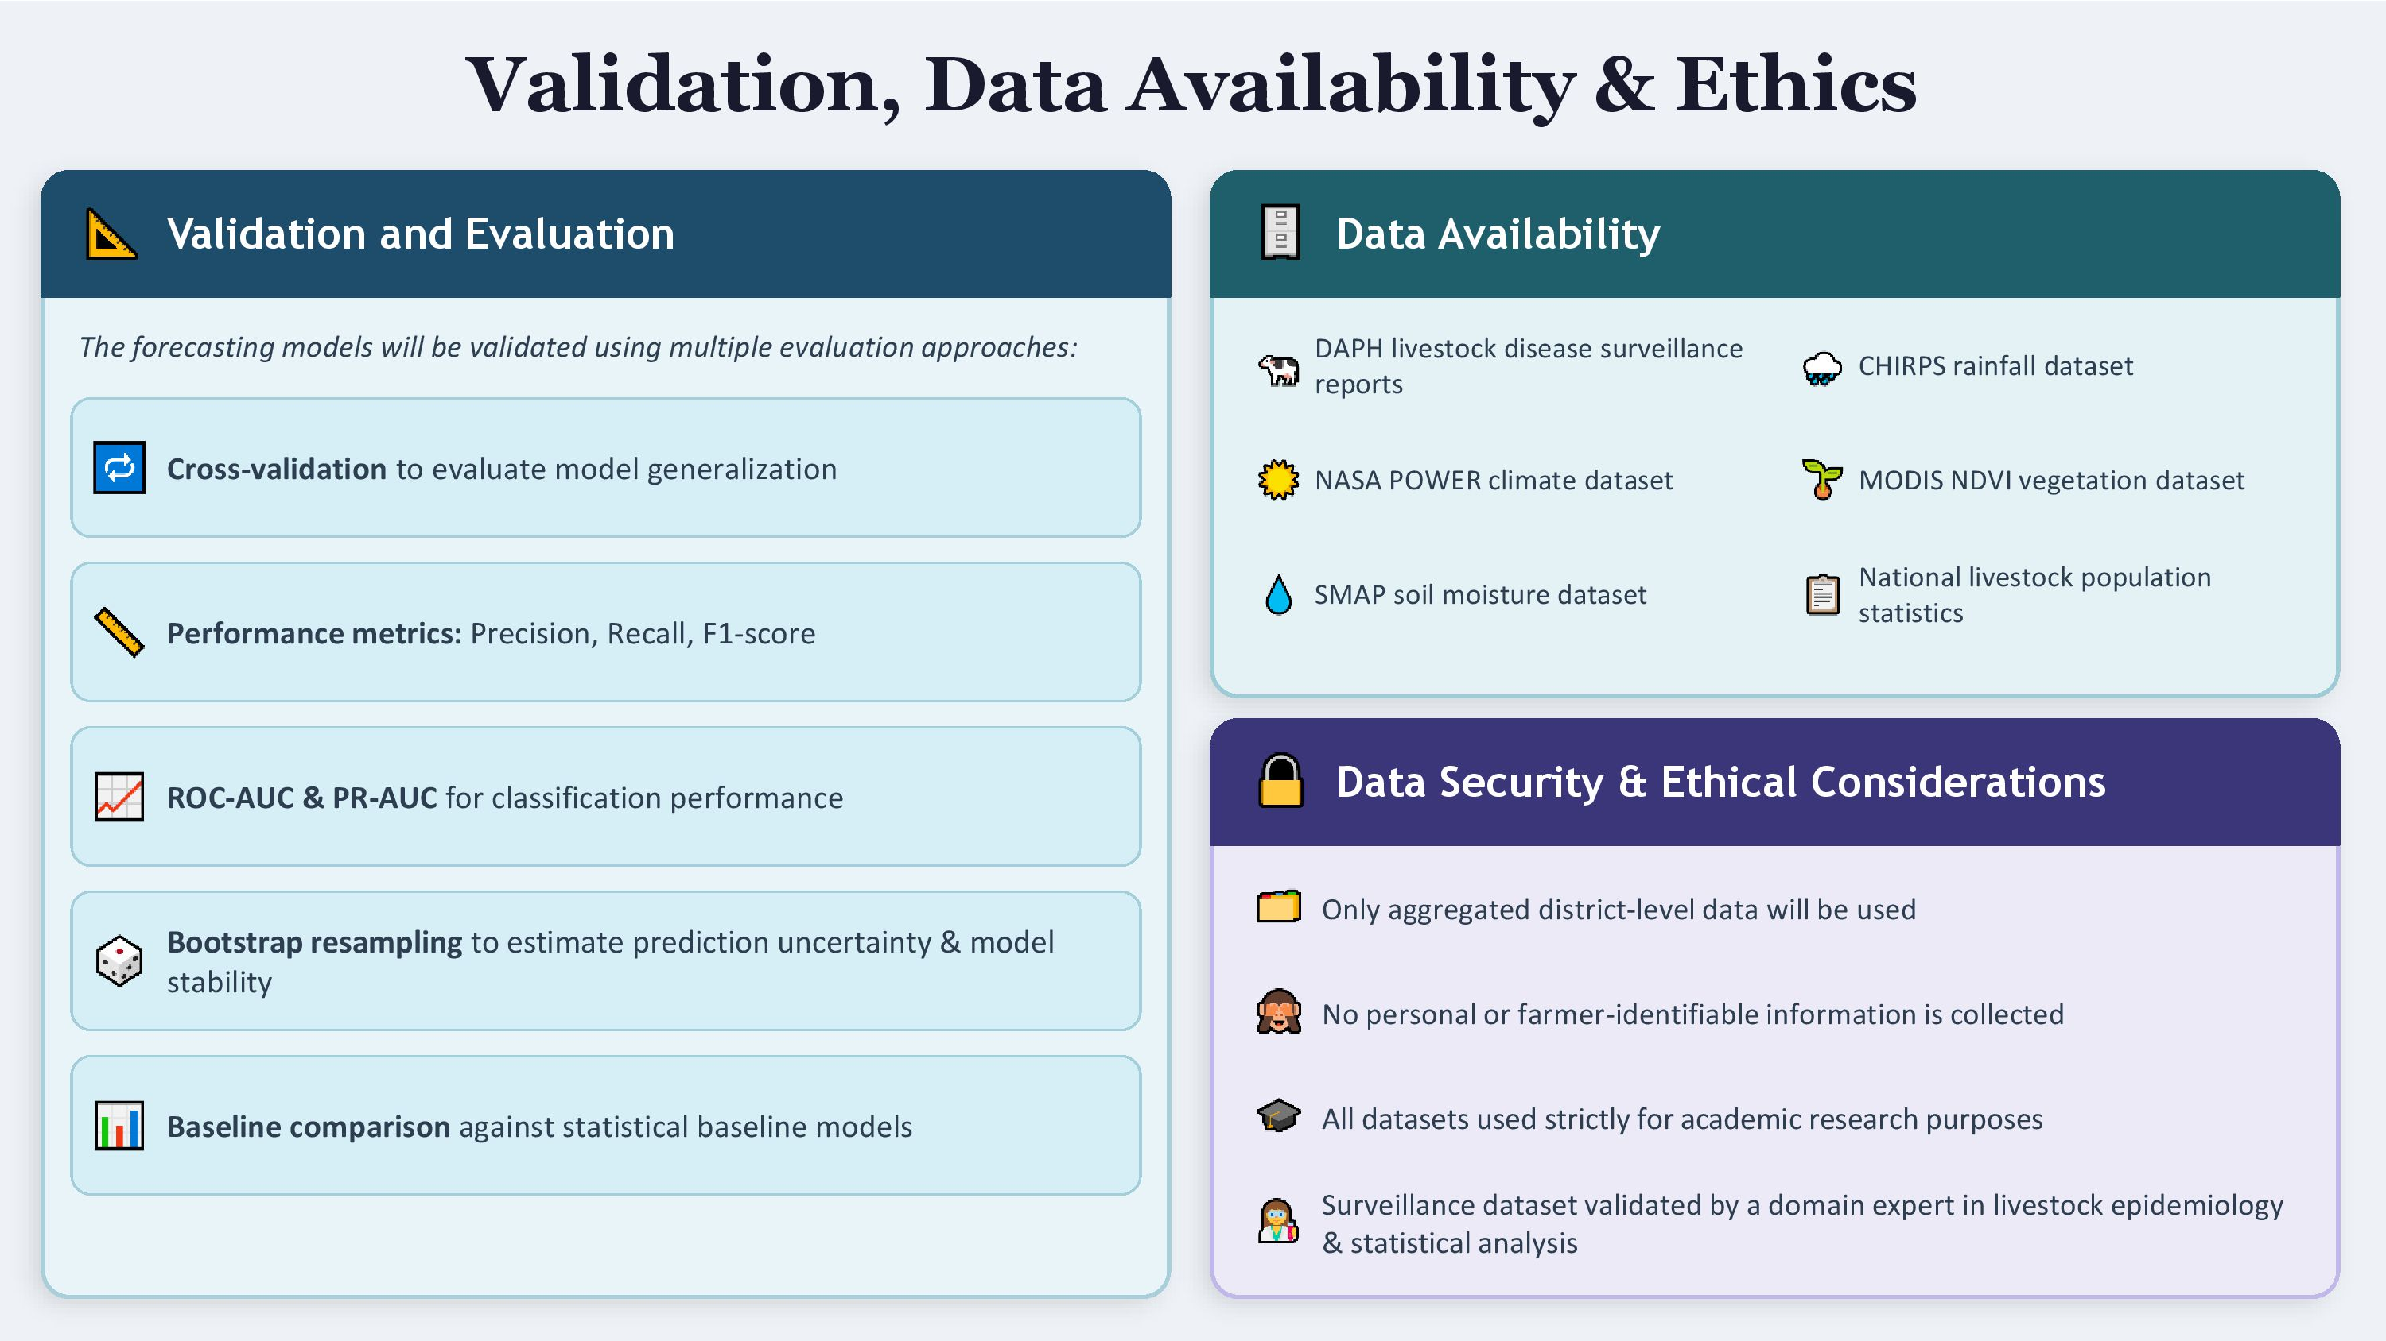
Individual Title
IT22221414 | Kumarasinghe S.S | R26-SE-013

Slide 27
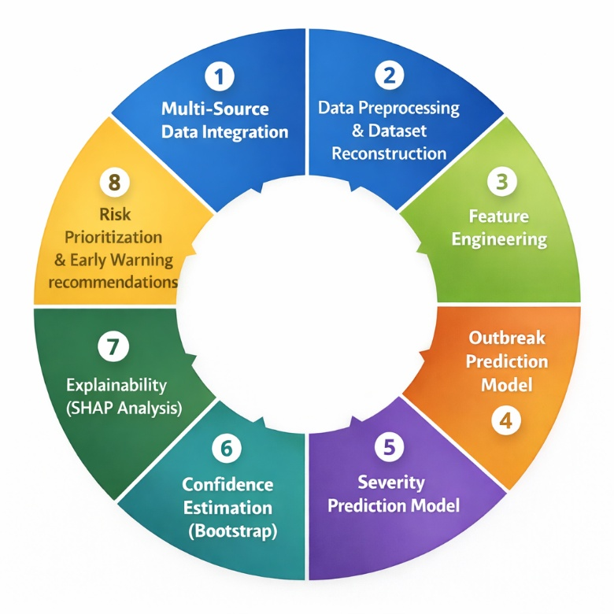
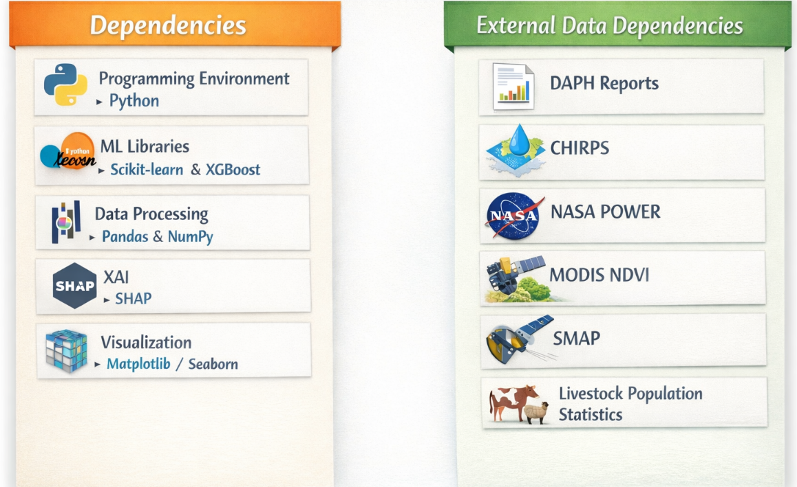
Individual Title
System Overview of the Individual Component
The component implements a climate-informed livestock disease forecasting and early warning module that transforms surveillance and environmental data into meaningful outbreak risk predictions.
Main
Modules
IT22221414 | Kumarasinghe S.S | R26-SE-013

Slide 28

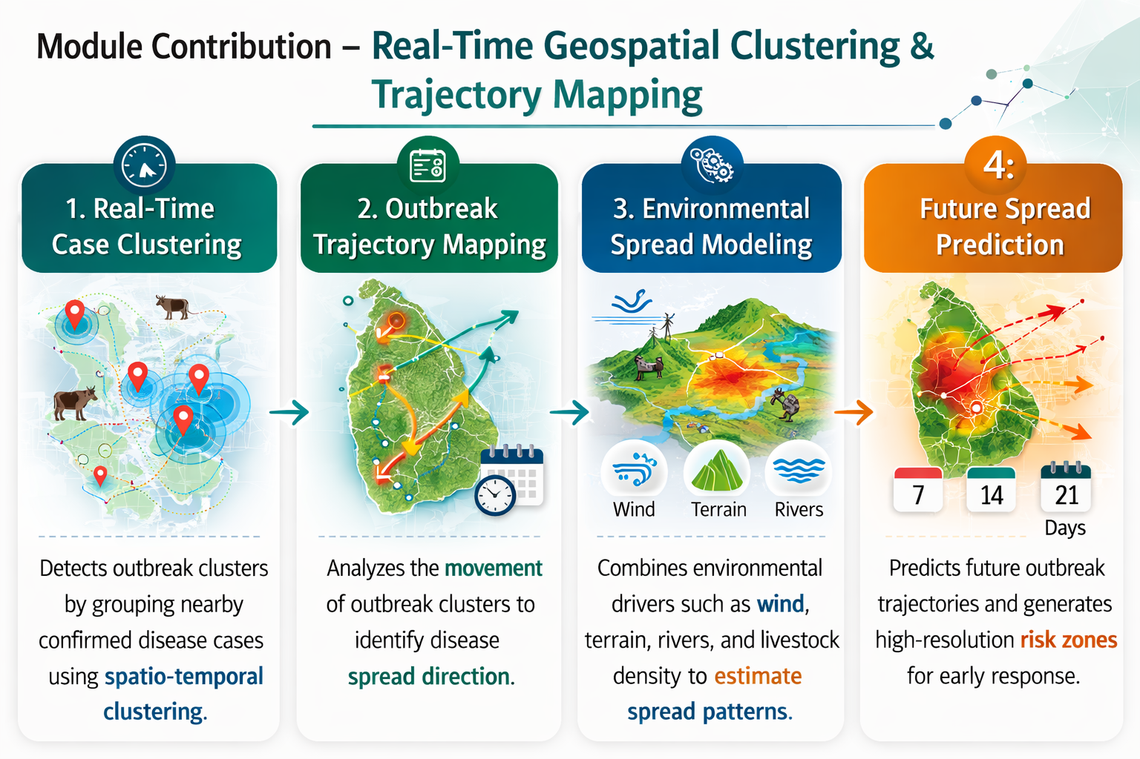
IT22258908 | Sanadaru G A
Real-Time Geospatial Clustering & Trajectory Mapping
IT22258908| Sandaru G A | R26-SE-013

Slide 29
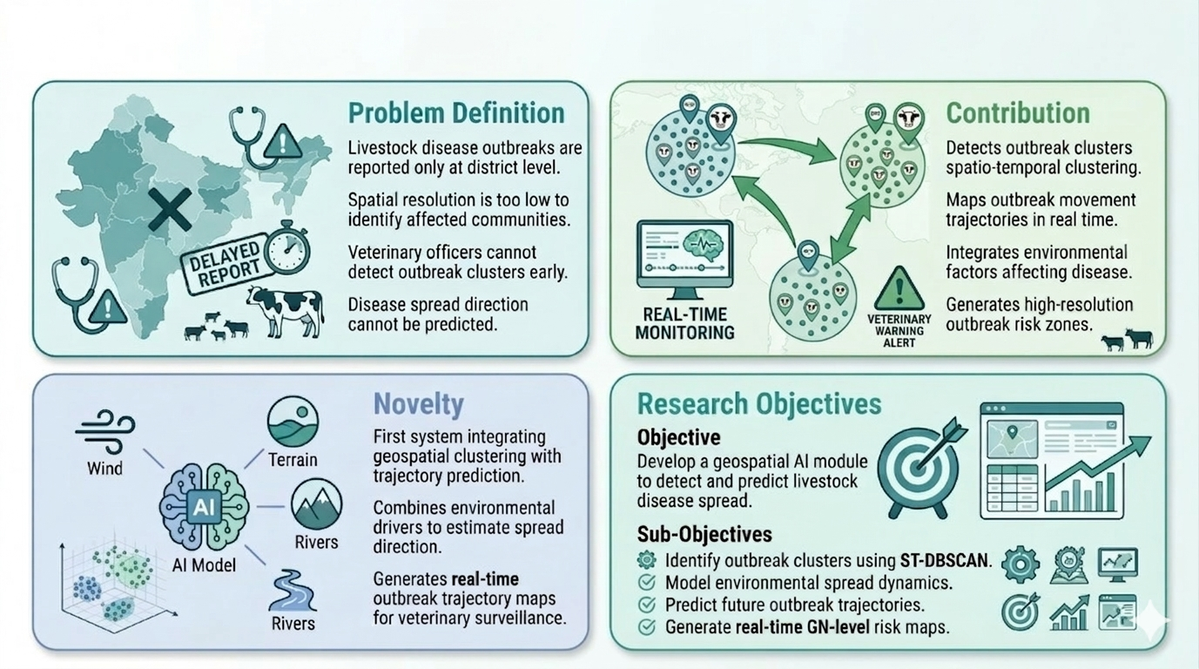
Real-Time Geospatial Clustering & Trajectory Mapping
IT22258908| Sandaru G A | R26-SE-013

Slide 30
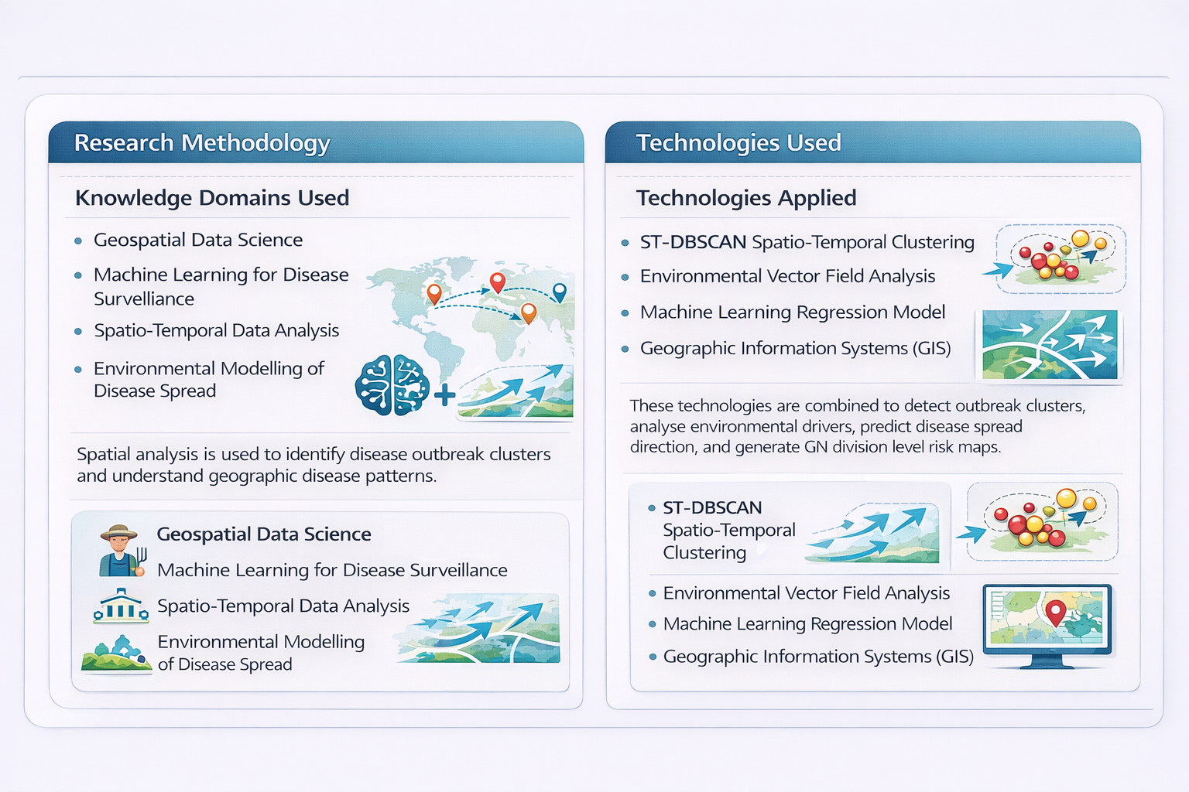
Real-Time Geospatial Clustering & Trajectory Mapping
Real-Time Geospatial Clustering & Trajectory Mapping
Real-Time Geospatial Clutering & Trajectory Mapping
IT22258908| Sandaru G A | R26-SE-013

Slide 31
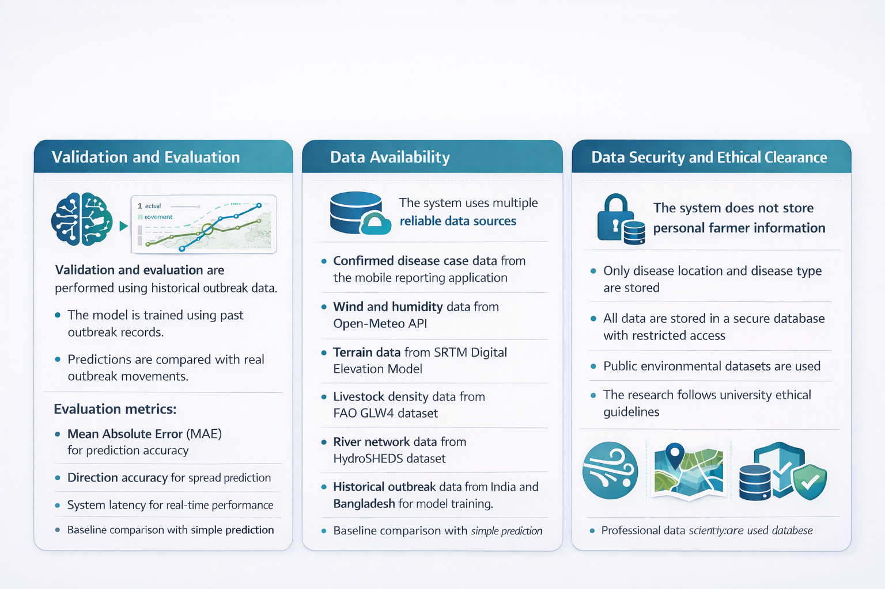
Real-Time Geospatial Clustering & Trajectory Mapping ​
​
​
IT22258908| Sandaru G A | R26-SE-013 ​

Slide 32
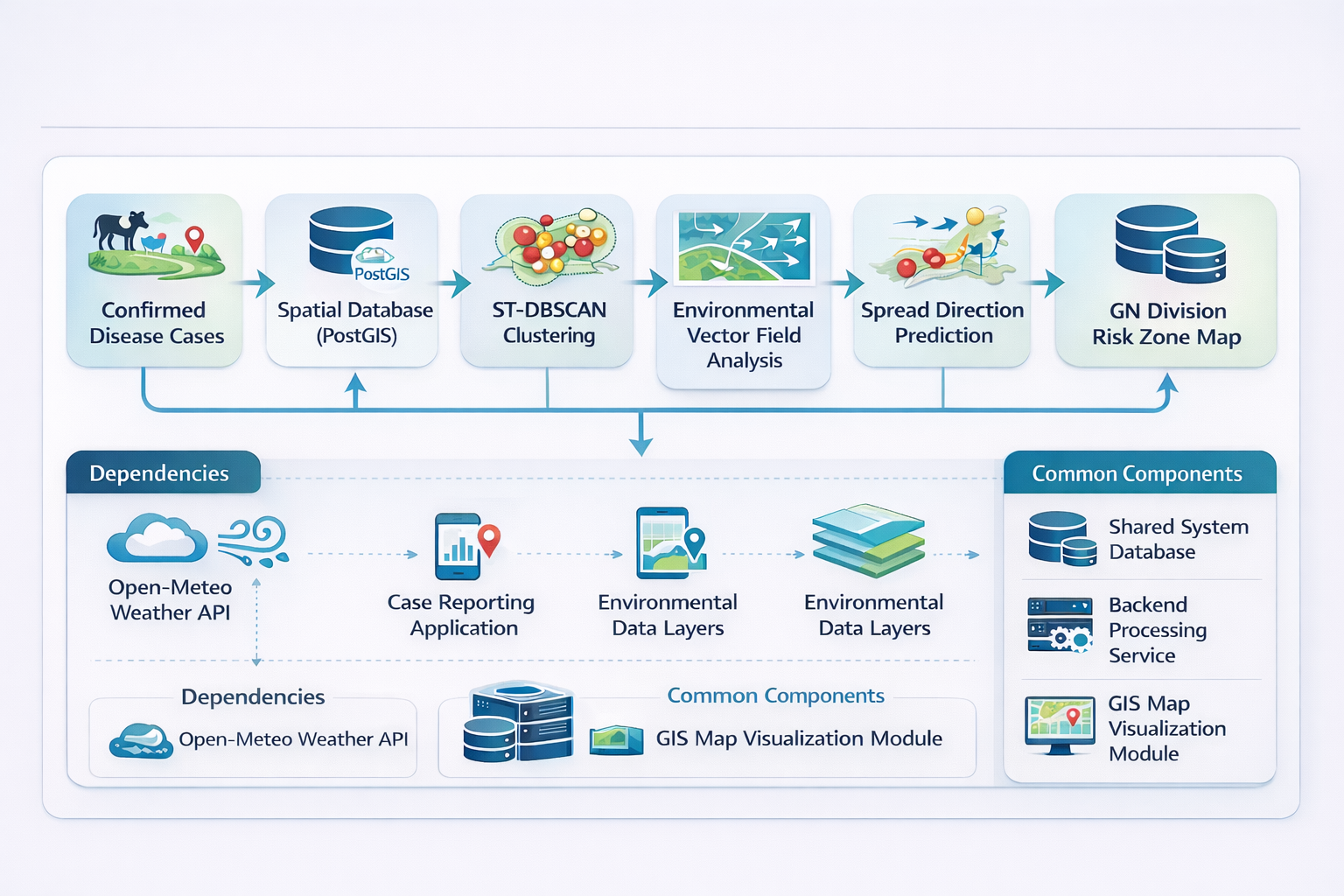
Real-Time Geospatial Clustering & Trajectory Mapping
IT22258908| Sandaru G A | R26-SE-013 ​

Slide 33
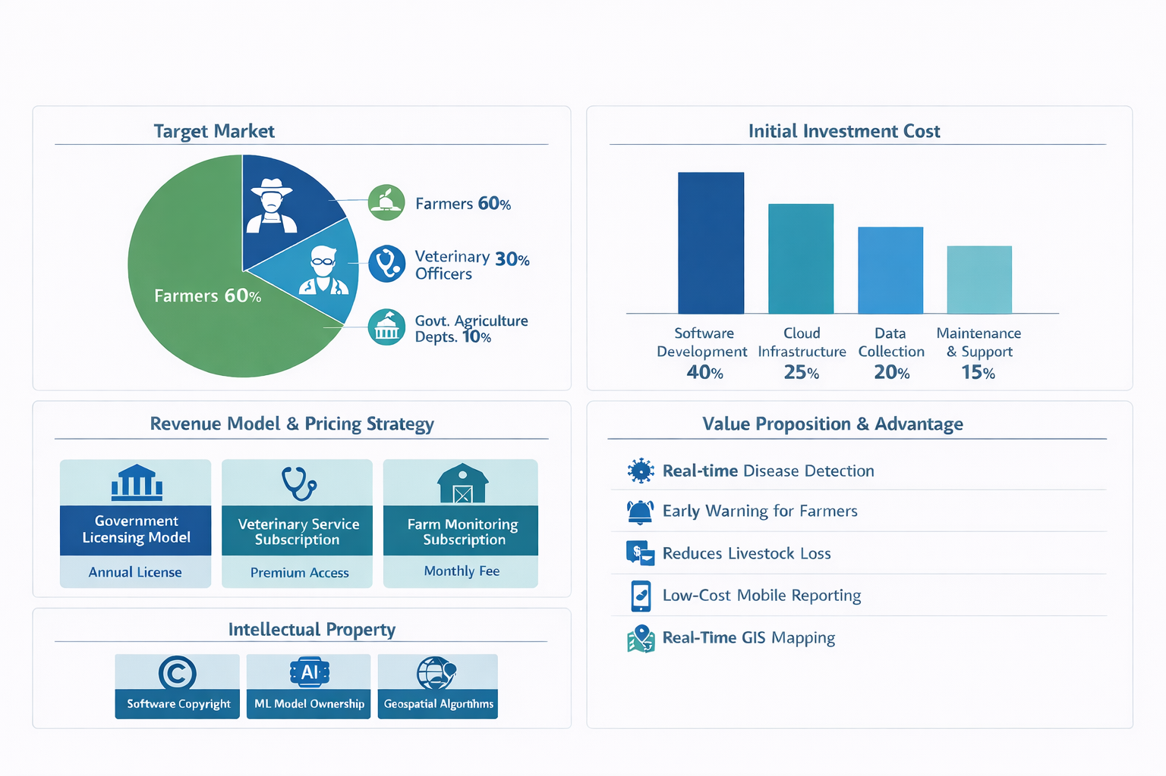
Overall Project Title
A Centralized System for Real-Time Farm Animal Disease Reporting

Slide 34
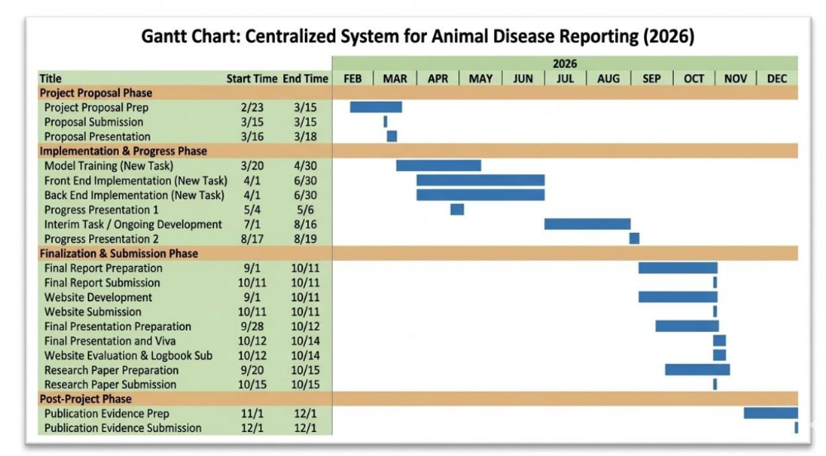
Overall Project Title
Gantt Chart

Slide 35
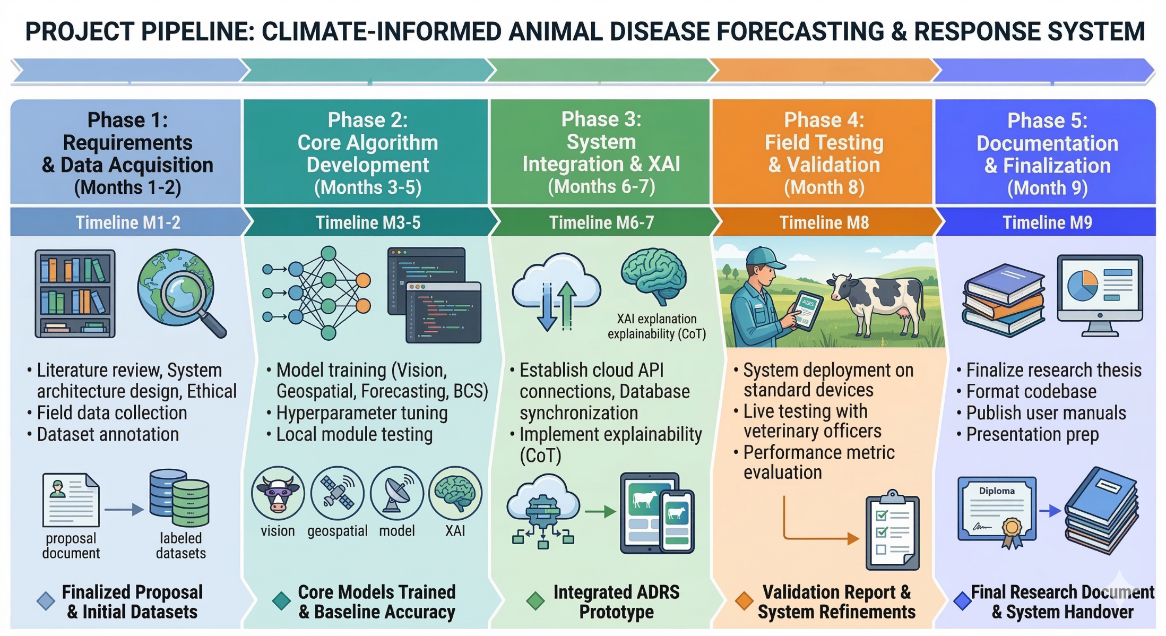
Overall Project Title
Work Breakdown Structure

Slide 36
THANK YOU!

